Slide 1

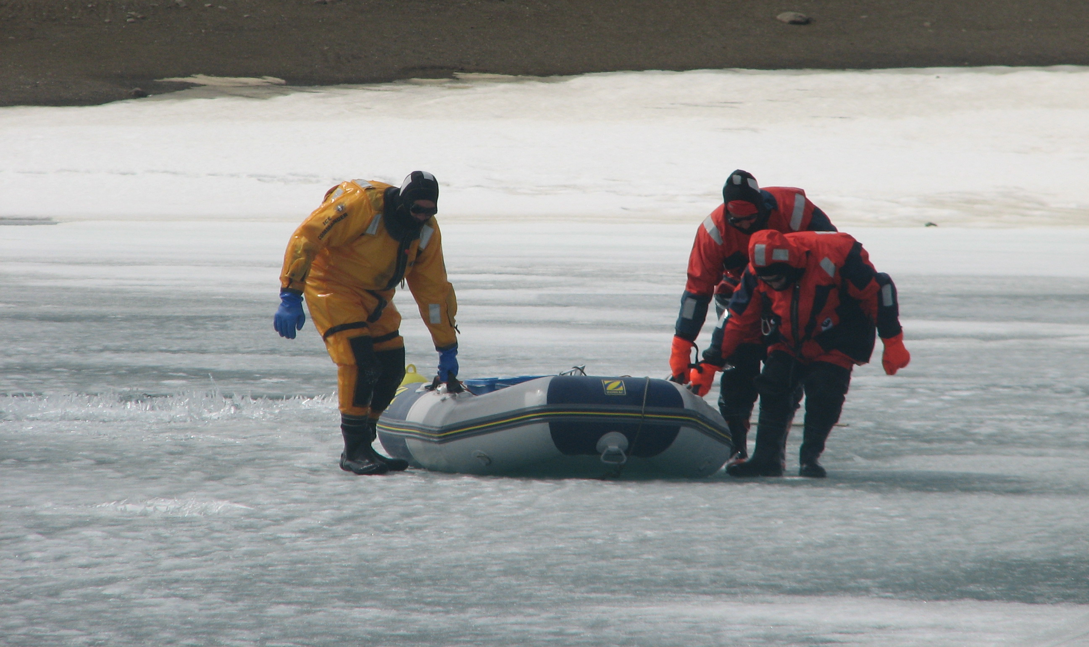
GLEON 2026 All Hands’ Meeting - Lake Banyoles (Spain)
August 28 - September 4
Workshop on Sunday, 30 August (10:00-13:00):
Winter limnology:
The Art of Instrumenting
Remote Lakes
(Without Dying in the Process)
Lake Limnopolar (Byers Peninsula)
Coord.: Manuel Toro & Ignacio Granados
(manuel.toro@cedex.es ; ignacio.granados@pnsg.es)

Slide 2
GLEON 2026 All Hands’ Meeting - Lake Banyoles (Spain)
August 28 - September 4
Introduce yourself:
Name:
Institution
Very brief description of your experience in winter limnology
Lake Limnopolar (Byers Peninsula)
Coord.: Manuel Toro & Ignacio Granados
(manuel.toro@cedex.es ; ignacio.granados@pnsg.es)

Slide 3
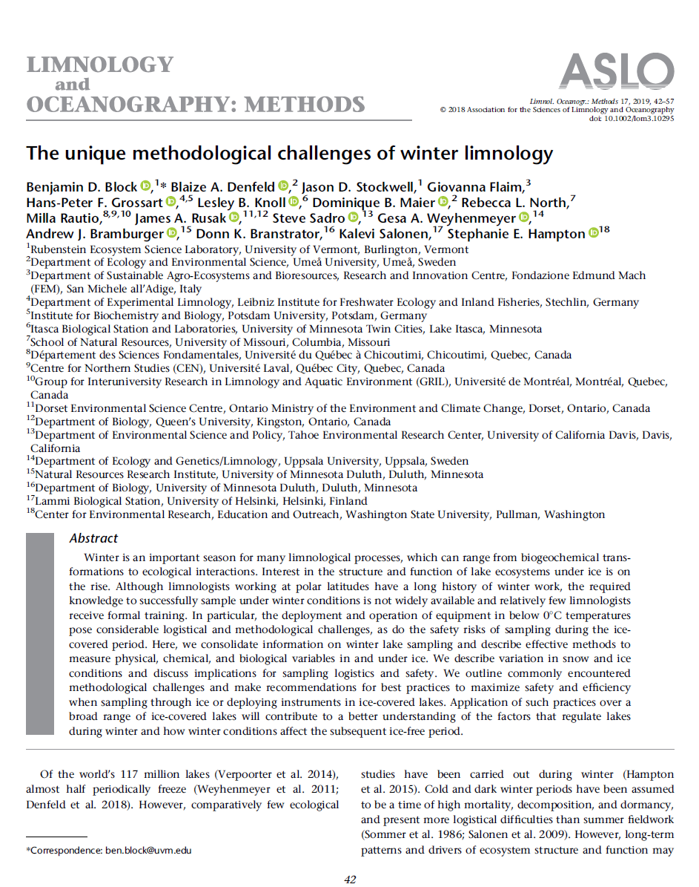
Workshop: Winter limnology: The Art of Instrumenting
Remote Lakes (Without Dying in the Process)
GLEON 2026 All Hands’ Meeting
Lake Banyoles (Spain) ; August 28 - September 4
“In addition, continued active dialog will help develop creative new methods, lower barriers for researchers to initiate winter work, and facilitate integrative and comparative winter studies across globally distributed lakes.”

Slide 4

Workshop: Winter limnology: The Art of Instrumenting
Remote Lakes (Without Dying in the Process)
GLEON 2026 All Hands’ Meeting
Lake Banyoles (Spain) ; August 28 - September 4
1. Objectives:
A revision/catalogue of field-tested practical solutions and experiences.
A list of common mistakes and things that have failed in the field.
A list of unresolved problems and outstanding challenges.
A network of contacts with experience in the topics discussed.
A shared collection of visual materials and documentation
that can serve as the basis for a later workshop synthesis
or GLEON document
And have fun!
  Shared exchange folder: https://folders.tools.nom.es/GLEON/

Slide 5
Workshop: Winter limnology: The Art of Instrumenting
Remote Lakes (Without Dying in the Process)
GLEON 2026 All Hands’ Meeting
Lake Banyoles (Spain) ; August 28 - September 4
Workshop Agenda:
Welcome and introduction: presentations and objectives
Lightning talks: “Bring your best trick or your worst disaster”
Thematic blocks: - Logistic: transport & storage
- Reaching sampling point
- Equipment deployment/recovery
- Instrumentation
- Personal equipment
Coffee Break (11:05-11:30)
Results, synthesis and discussion
              Take away messages
              Best field hack/Most creative solution
              Most recurrent failures
              Problems that remain unsolved
Closing and next steps: report, wiki-doc, list-, blog, collaborations, ideas?

Slide 6
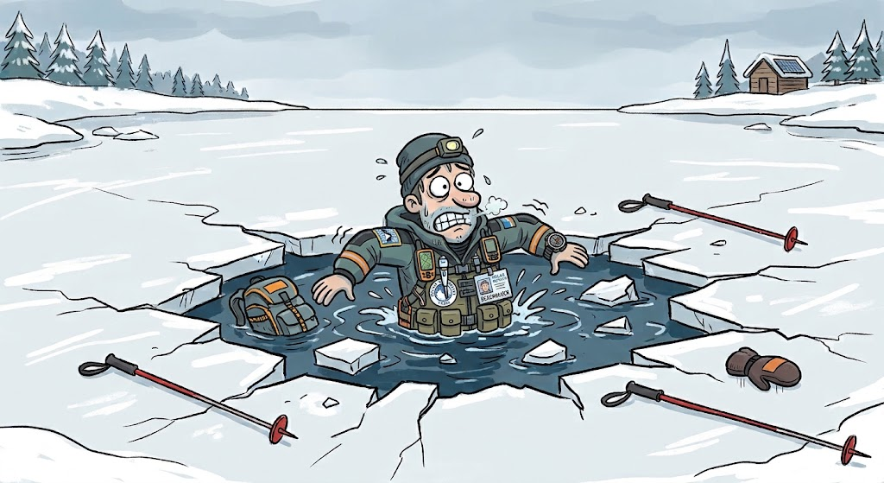


Workshop: Winter limnology: The Art of Instrumenting
Remote Lakes (Without Dying in the Process)
GLEON 2026 All Hands’ Meeting
Lake Banyoles (Spain) ; August 28 - September 4
2. Lightning talks:
Which is your best trick!
Which is your worst disaster!
Briefly tell us what happened and what you learned from it
https://folders.tools.nom.es/GLEON/

Slide 7
Workshop: Winter limnology: The Art of Instrumenting
Remote Lakes (Without Dying in the Process)
GLEON 2026 All Hands’ Meeting
Lake Banyoles (Spain) ; August 28 - September 4
3. Thematic blocks:
Logistic in remote lakes: transport & storage
Reaching the sampling point: access and safety
Equipments deployment and recovery: buoys, mooring systems, …
Instrumentation: brands, configuration, open-source hardware, …
Personal equipment: the Winter limnologist’s “must-haves”
We need a voluntary scribe to take notes, preferable an early-career researcher
https://folders.tools.nom.es/GLEON/

Slide 8
Workshop: Winter limnology: The Art of Instrumenting
Remote Lakes (Without Dying in the Process)
GLEON 2026 All Hands’ Meeting
Lake Banyoles (Spain) ; August 28 - September 4
3. Thematic block: 01 Logistic in remote lakes: transport & storage
Possible questions:
How do you store your material in the field? Do you use vandal-proof and/or waterproof systems?
How do you transport heavy or fragile equipment? What is the heaviest thing you have transported?
What always breaks during transport? What do you never transport again?
What limnological material would you like to be more transportable?
Usually do you have problems to reach enough team member for logistic?
https://folders.tools.nom.es/GLEON/

Slide 9
Workshop: Winter limnology: The Art of Instrumenting
Remote Lakes (Without Dying in the Process)
GLEON 2026 All Hands’ Meeting
Lake Banyoles (Spain) ; August 28 - September 4
3. Thematic block: 02 Reaching the sampling point: access and safety
Possible questions:
Rise you hand if you have ever fall trough the ice!
What is your minimum safety equipment?
How do you decide if the ice will support your weight? What was nearly gone wrong?
How do locate your sampling point (sensors) under heavy snow cover?
Which is the thickest ice-cover you have ever found?
Have you ever found ice-cover too much thin to walk and to much thick to sail?
https://folders.tools.nom.es/GLEON/

Slide 10
Workshop: Winter limnology: The Art of Instrumenting
Remote Lakes (Without Dying in the Process)
GLEON 2026 All Hands’ Meeting
Lake Banyoles (Spain) ; August 28 - September 4
3. Thematic block: 03 Equipments deployment and recovery:
buoys, mooring systems, …
Possible questions:
Who has lost sensors or a whole mooring experimental system? Due to natural or human reasons?
Which is the more complex installation you have you have ever done?
How do you prevent buoys became pulled by drifting ice during thaw?
What is the best approach: deploy the experimental design during ice-free and wait to the winter or deploy from the ice-cover? How do you deploy the system?
Which type or ropes and buoys are the best for you? How do you build a heavy anchor without the need to transport it to the lake?
Do you want to share your best trick?
https://folders.tools.nom.es/GLEON/

Slide 11
Workshop: Winter limnology: The Art of Instrumenting
Remote Lakes (Without Dying in the Process)
GLEON 2026 All Hands’ Meeting
Lake Banyoles (Spain) ; August 28 - September 4
3. Thematic block: 04 Instrumentation: brands, configuration, open- source hardware, …
Possible questions:
What are your preferred brand for your field sensors? Which brand you will never use again? Do you use open-source hardware?
How do you deal with the biofouling?
Have you compared sensors from different brands or models side-by-side? Do they agree?
How many times do you find empty data or died batteries at the end of the season?
Usually do you leave unattended sensors, or do you manage any kind of remote communication?
Other experiences with non-electronical material (corers, sediment traps, water sampling,…)?
https://folders.tools.nom.es/GLEON/

Slide 12
Workshop: Winter limnology: The Art of Instrumenting
Remote Lakes (Without Dying in the Process)
GLEON 2026 All Hands’ Meeting
Lake Banyoles (Spain) ; August 28 - September 4
3. Thematic block: 05 Personal equipment: the Winter limnologist’s “must-haves”
Possible questions:
What are your “must-have” for a winter limnologist personal equipment?
What tools or devices do you find especially useful during sampling?
Which advice would you give to a student interested in winter limnology (not only about equipment)?
https://folders.tools.nom.es/GLEON/

Slide 13
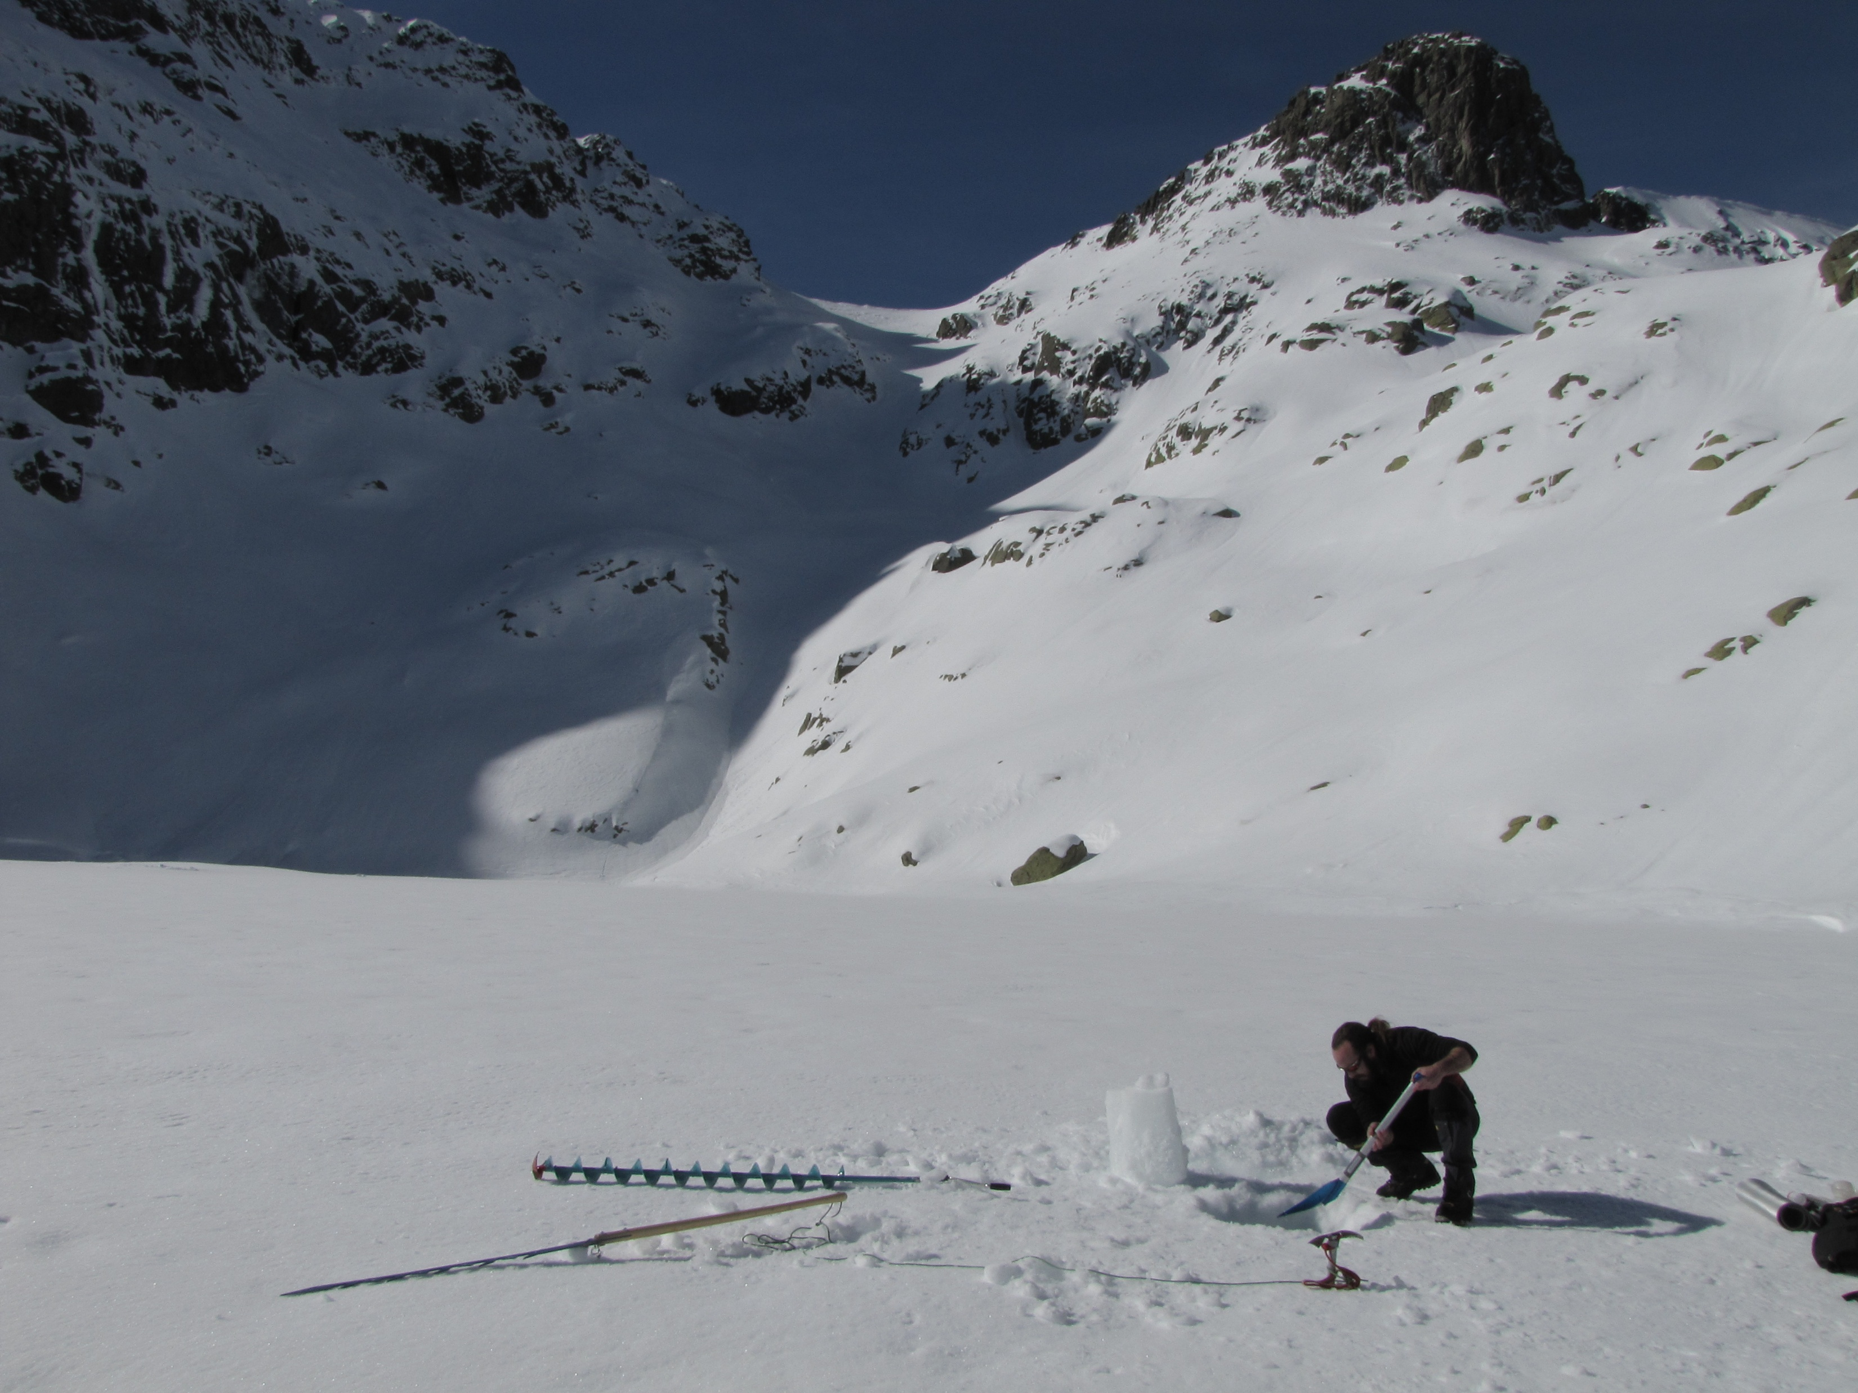
Workshop: Winter limnology: The Art of Instrumenting
Remote Lakes (Without Dying in the Process)
GLEON 2026 All Hands’ Meeting
Lake Banyoles (Spain) ; August 28 - September 4
5. Results synthesis and discussion:
Fast summary from the scribe ( ~ 1min/block)
Wall of sticky notes:
Take away messages
Best field hack/Most creative solution
Most recurrent failures
Problems that remain unsolved
“Don’t touch any running system”
“Field-proof beats perfect”
“The best is the enemy of the simply good”
https://folders.tools.nom.es/GLEON/

Slide 14
Workshop: Winter limnology: The Art of Instrumenting
Remote Lakes (Without Dying in the Process)
GLEON 2026 All Hands’ Meeting
Lake Banyoles (Spain) ; August 28 - September 4
6. Closing and next steps:
Technical GLEON report?
“Winter limnology Netwok”?
Live Wiki-doc?
Future collaborations/projects?
Ideas? ...
https://folders.tools.nom.es/GLEON/

